Slide 1
AI-DRIVEN EXPLORATION AND PREDICTION TRENDS
WITH THE REGISTER OF COMPANIES
NAME :J.EZHUMALAI
DEP/SEM :CSE – 05
REG NO : 212921104019
COLLEGE CODE : 2129
COLLECE NAME : SJCE

Slide 2
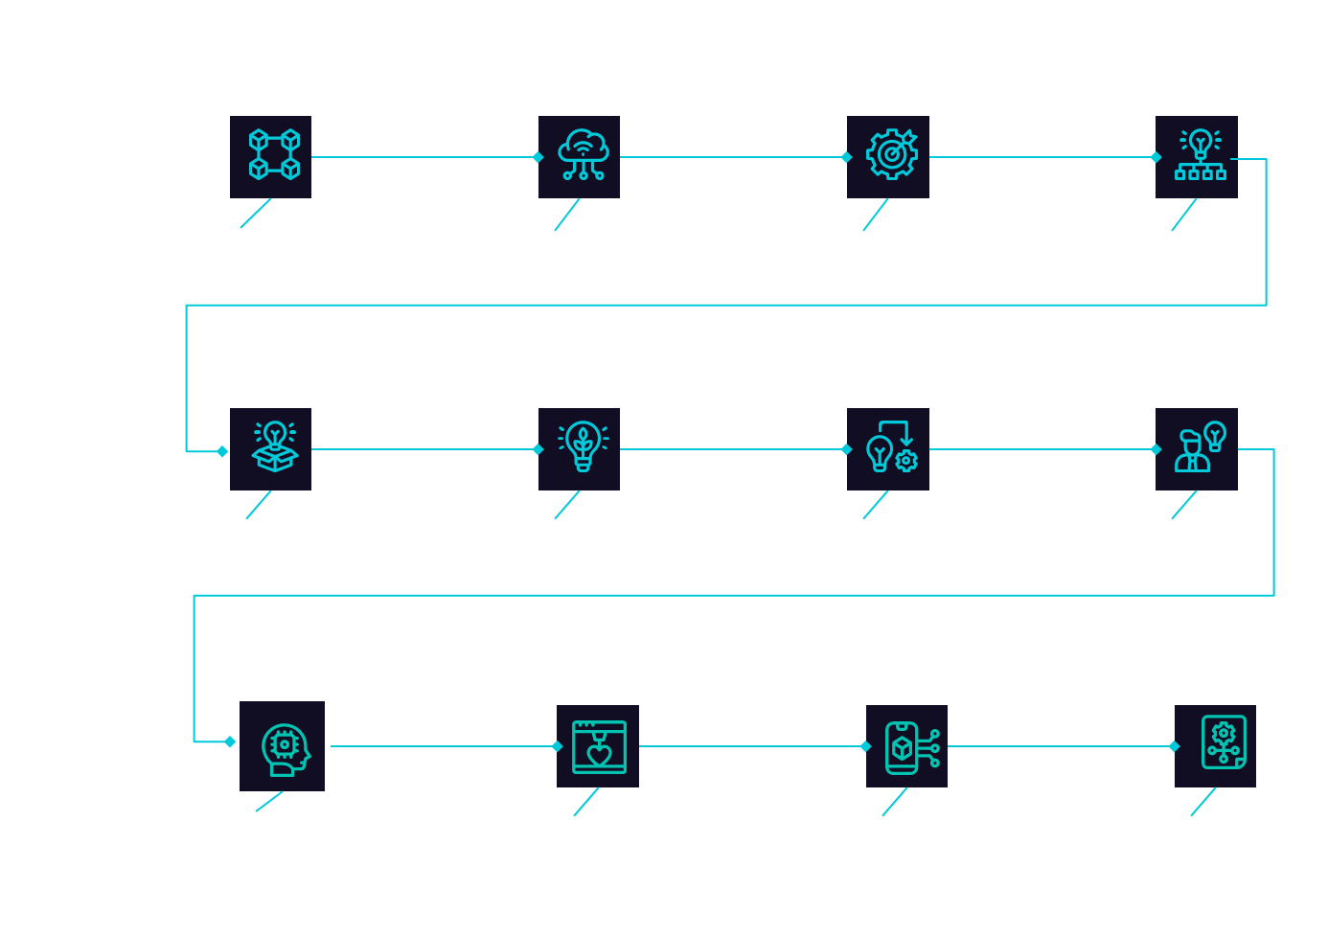

Slide 3
DATA COLLECTION
Gathering historical and real time data from the register of companies or relevant government authorities. This data should include information about company registrations , such as company names , registration dates , location, industry classifications and ownership details.

Slide 4
DATA PREPROCEESING
Clean and preprocess the collected data to handle missing values , duplicates and inconsistencies
Convert data into a structured format suitable analysis

Slide 5
FEATURE ENGINEERING
Create relevant feature from the raw data that can be used for analysis this may involve generating time series data, calculating growth rate ,or extracting additional information from the registration records.

Slide 6


EXPLORATORY DATA ANALYSIS
Used statistical and visualization techniques to explore the data ,EDA helps identify trends ,anomalies and pattern in historical company registrations.
IT can involve generating summary statistics creating visualization and performing time series analysis.

Slide 7

MACHINE LEARNING MODEL SELECTION
Choose appropriate machine learning algorithms for prediction.
Common choices include time series forecasting methods (eg:ARIMA, prophet),regression models or more advanced techniques like Deep learning for complex patterns .

Slide 8

TRAINING AND TESTING
Split the data into training and testing sets to evaluate the model performance .Ensure that the model can effectively capture historical trends and patterns .

Slide 9

MODEL TRAINING
Train the selected machine learning model using the training data. The model learns from historical registration data to make predictions .

Slide 10

EVALUATION
Assess the model accuracy and performance using the testing data set. Common evaluation metrics include Mean Absolute Error (MAE),Mean Squared Error (MSE) or Root Mean Squared Error(RMSE).

Slide 11
PREDICTION AND FORECASTING
Use the trained model to make predictions for future company registration trends.
This can include forecasting the number of new registration in specific time period or identifying potential shifts in industry preferences.

Slide 12


VISUALIZATION AND REPORTING
Present the results of the analysis and predictions through interactive dashboards ,reports and the visualization.
Clear and intuitive visualization tools can help stakeholders and act upon the insights.

Slide 13

CONTINUOUS MONITORING
Implement a system for ongoing monitoring and updating of the model. As new registration data becomes available , the model can retrained to provide up – to – date predictions .

Slide 14


DECISION MAKING AND STRATEGY
Use the insights and prediction to inform business strategies, investment decisions and policy formulation based on anticipated changes in companies registration trends.

